Slide 1

РОССИЙСКИЙ ПРОИЗВОДИТЕЛЬ c 1990 г.

Slide 2



ECROSKHIM LTD.
Production of laboratory equipment and furniture, development and implementation services, wholesale and retail sales.
ECROS GROUP OF COMPANIES
ECROS TRADING HOUSE LTD.
Laboratory equipment supplies.
www.ecohim.ru

Slide 3



2020
2015
Launching of X-ray analytical instruments production: spectrometers and diffractometers
HISTORY OF THE COMPANY
2012
Start of overseas supplies of equipment to OPEC countries. Supplies to Pakistan, Israel, Nigeria, Serbia, Saudi Arabia.
The reorganization of the company structure and the shift of business strategy
2008
2005
ECROS Group of Companies becomes the largest manufacturer of laboratory equipment in Russia (1500 employees, 22 representative offices)
1999
Obtaining of the international certificate ISO 9001:2000
1997
Launching of the plastic manufacturing
1993
Start of laboratory furniture production
1991
Certified reference materials
1990
Start of general laboratory equipment production
The date of foundation of ECROS Company.
www.ecohim.ru

Slide 4


ECROSKHIM TODAY
The whole production cycle of general laboratory equipment, visualization of laboratory projects and manufacturing of furniture according to customers requests
More than 240 employees and high-educated specialists
Our own plastic manufacturing site
Development and production of X-ray analytical analyzers: spectrometers and diffractometers
Two certified laboratories developing and manufacturing certified reference materials for oil and petroleum products analysis, gas chromatography, indicator PH paper, volumetric standards, etc.
A major Russian manufacturer of laboratory and analytical equipment
www.ecohim.ru

Slide 5

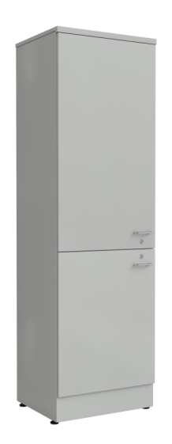
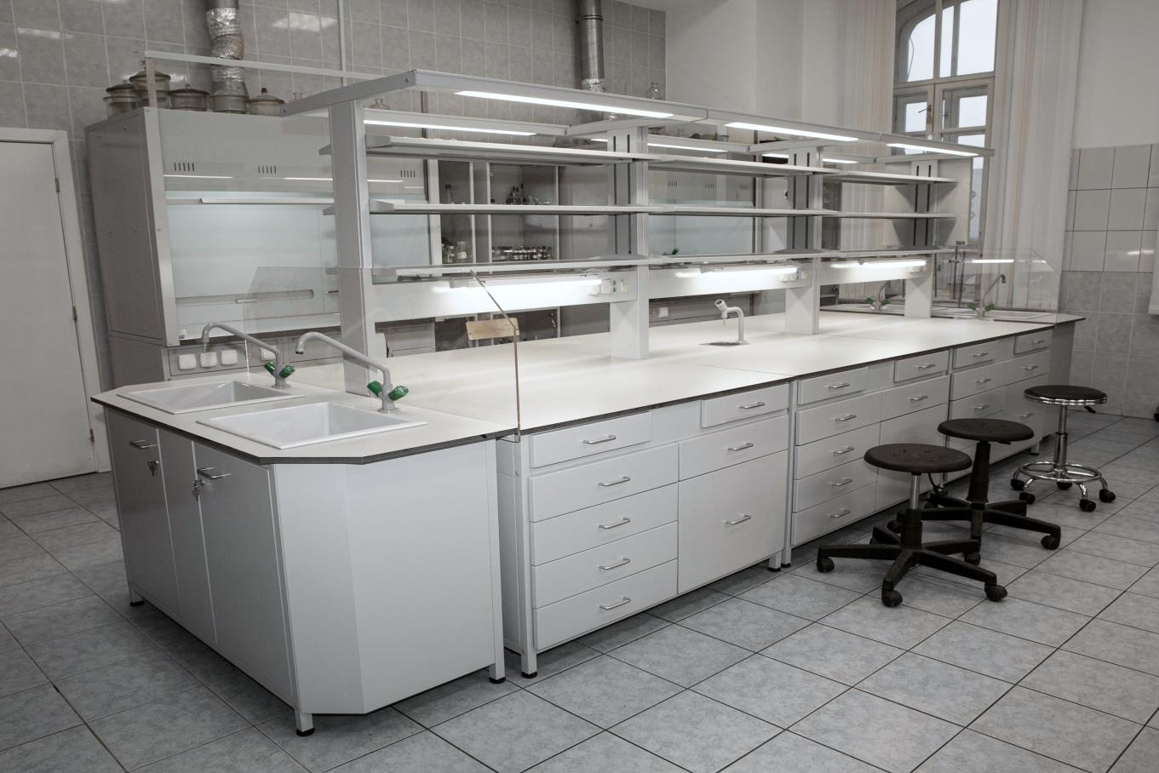
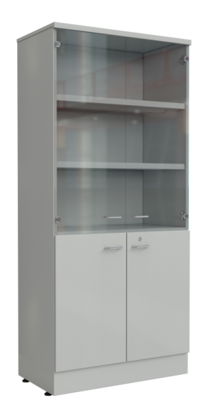
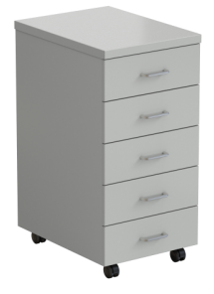
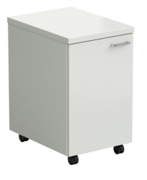
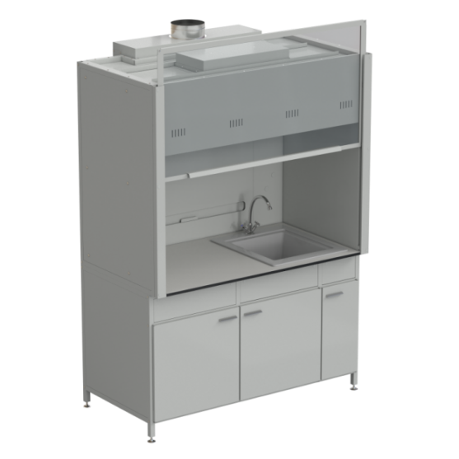
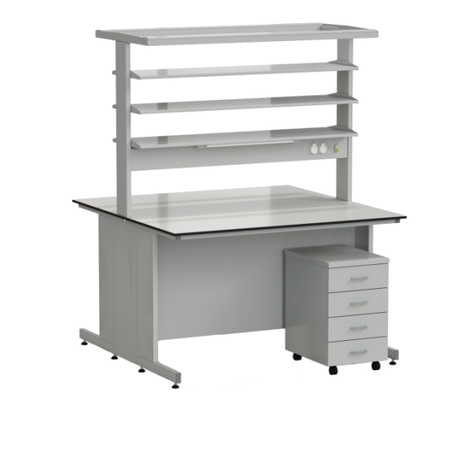
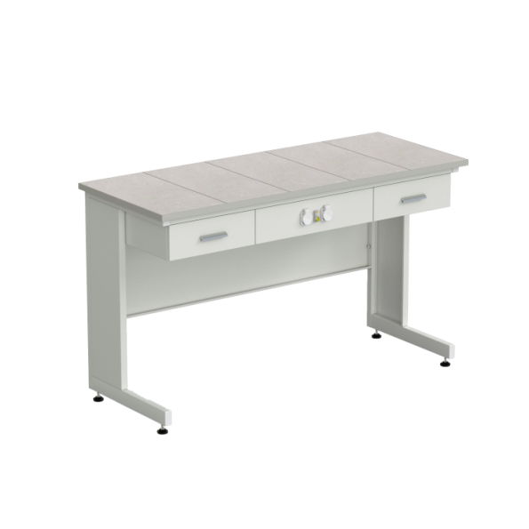
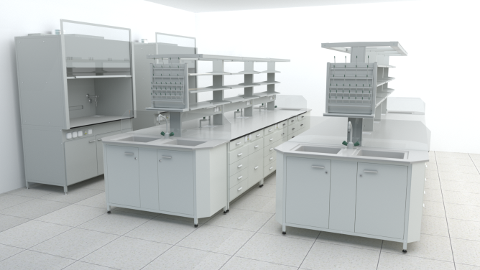
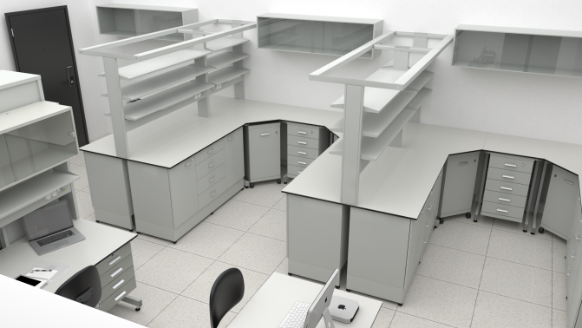
LABORATORY FURNITURE MANUFACTURING
www.ecohim.ru

Slide 6

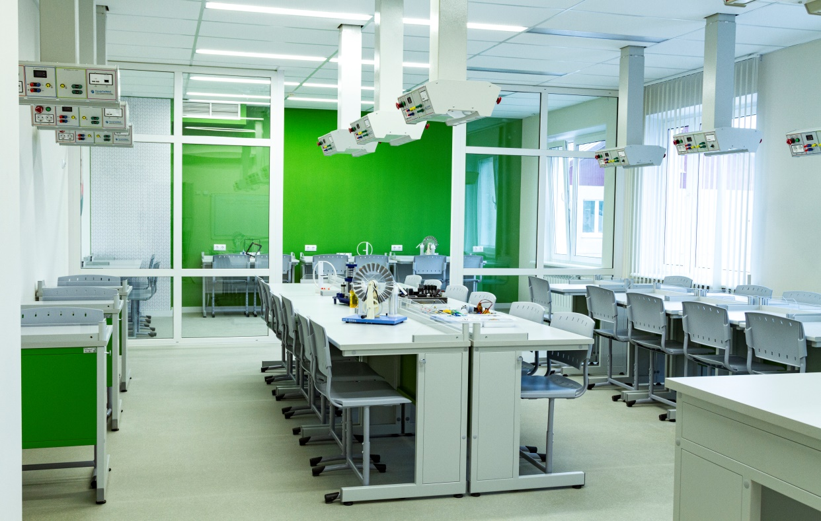

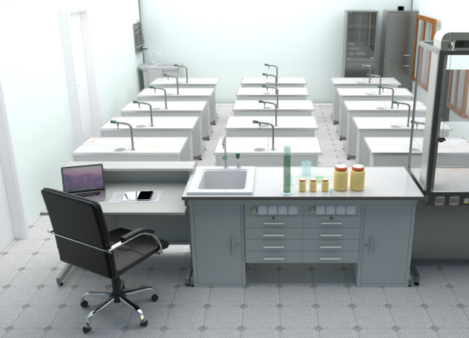
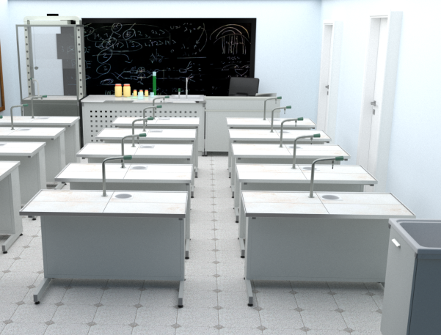
STUDENT LABORATORY FURNITURE “EVRIKA”
www.ecohim.ru

Slide 7

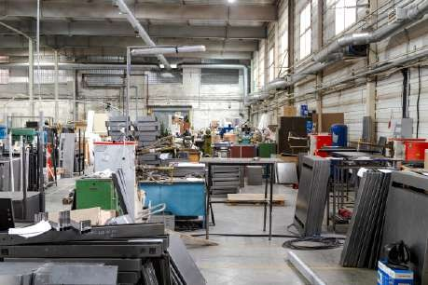
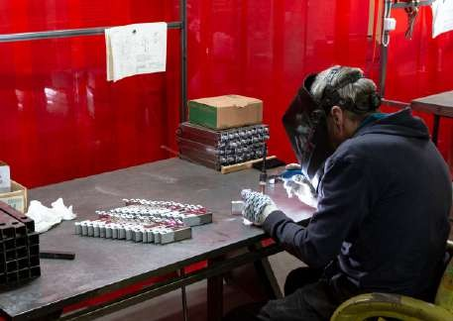
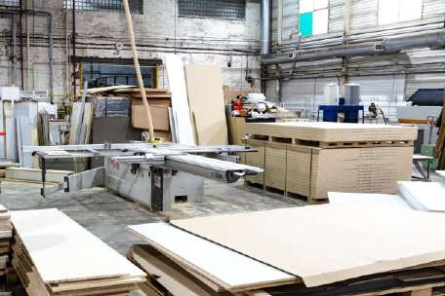

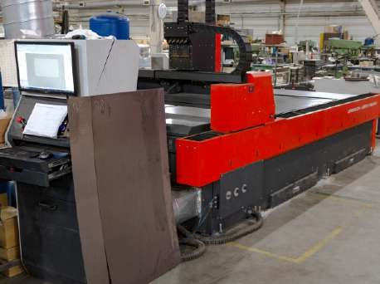
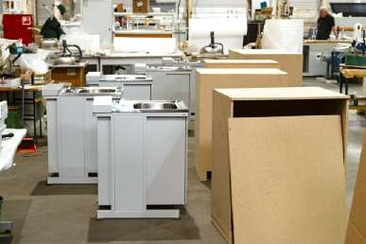
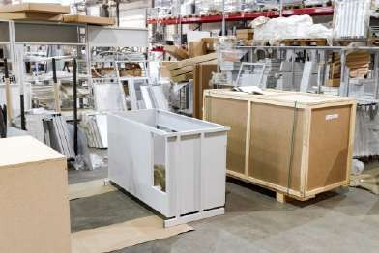
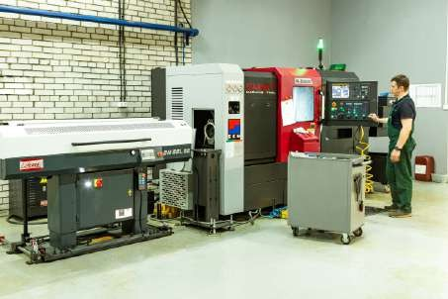
FURNITURE MANUFACTURING
www.ecohim.ru

Slide 8


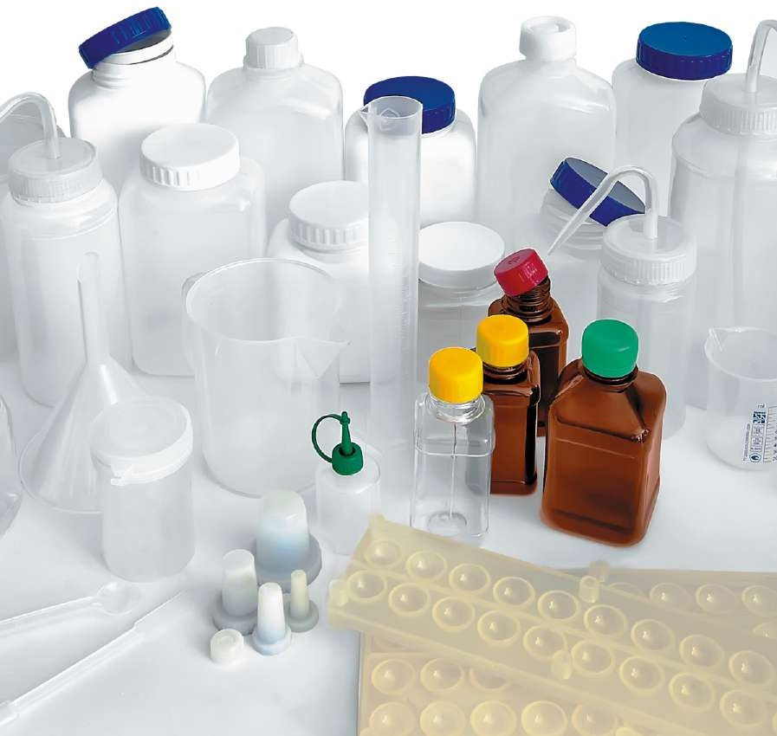

LABORATORY WARE
AND PLASTIC
Injection molding on modern injection molding and blow molding machines.
Over 100 proprietary mold designs.
www.ecohim.ru

Slide 9


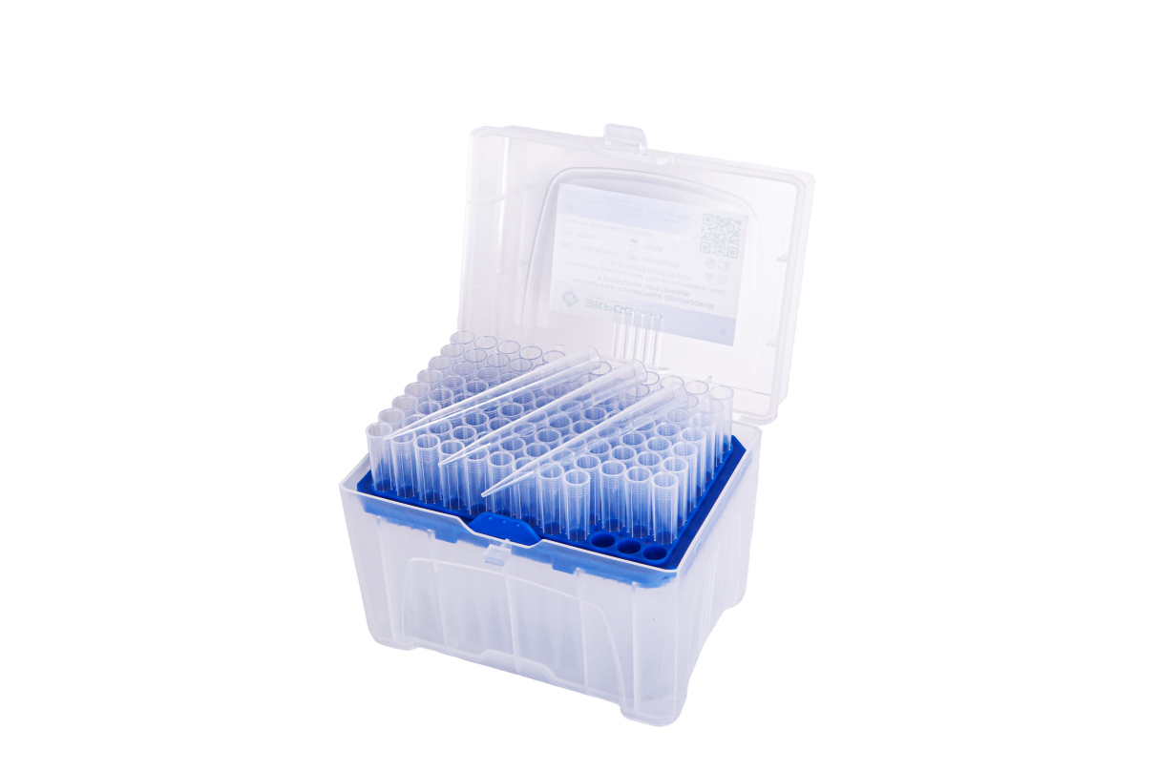

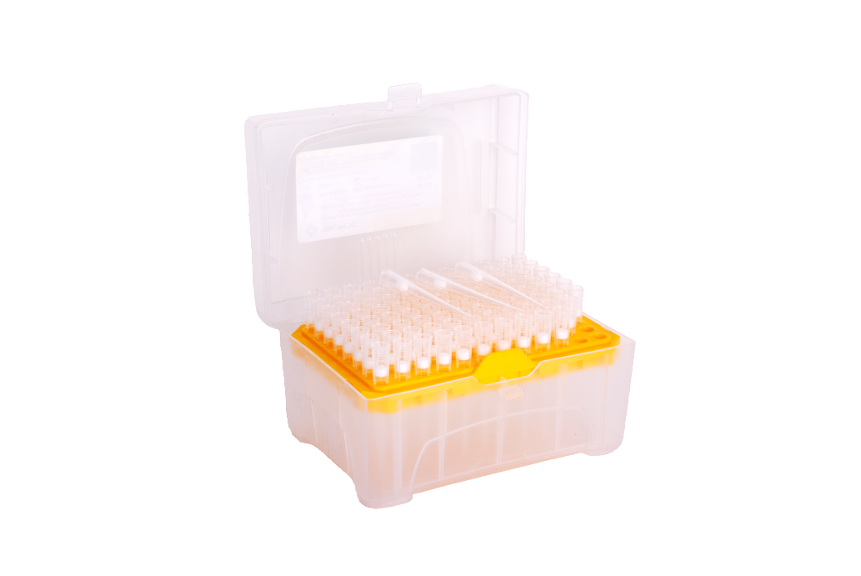
PIPETTE TIPS
www.ecohim.ru

Slide 10


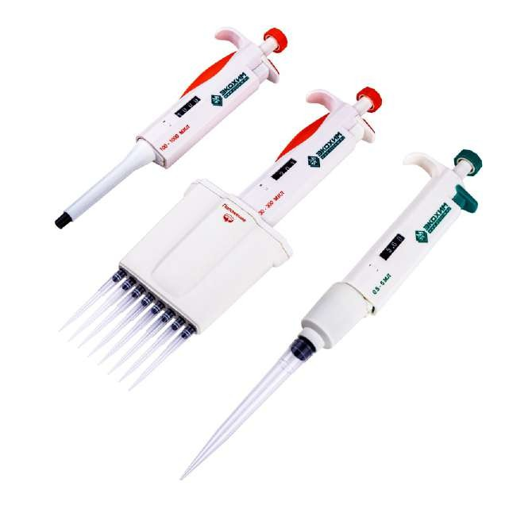
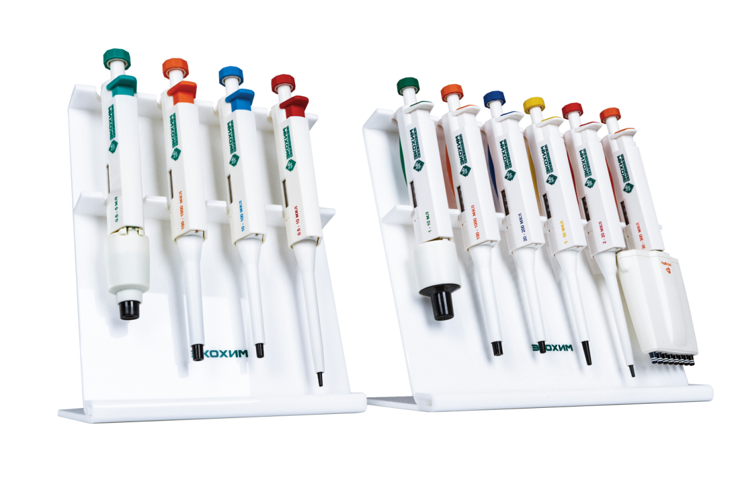

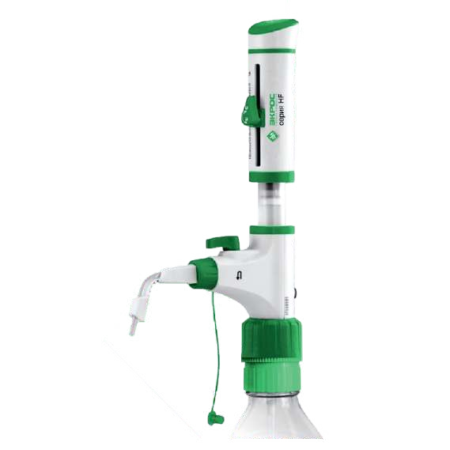

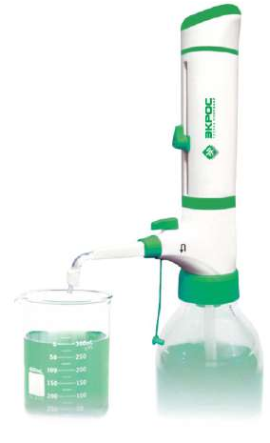
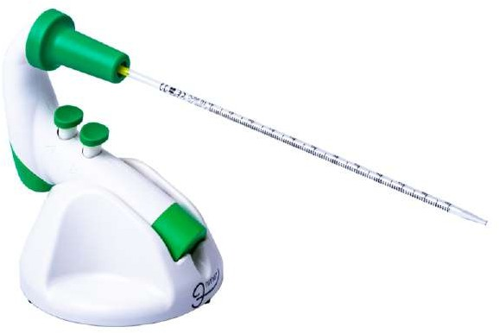
LIQUID HANDLING INSTRUMENTS:
MECHANICAL PIPETTES
AUTOMATIC PIPETTES
DISPENSERS
www.ecohim.ru

Slide 11

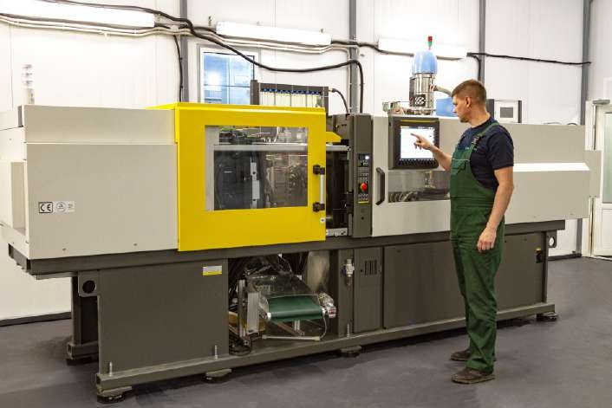

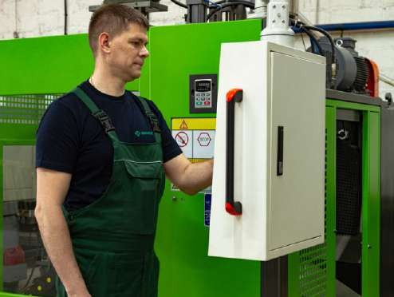
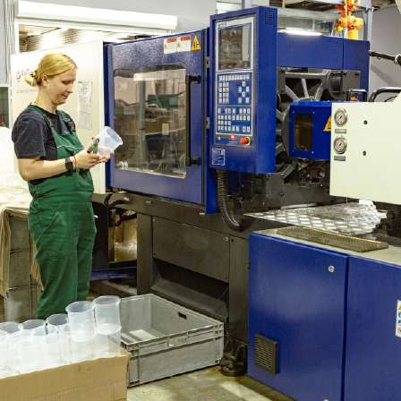
PLASTIC MANUFACTURING
www.ecohim.ru

Slide 12
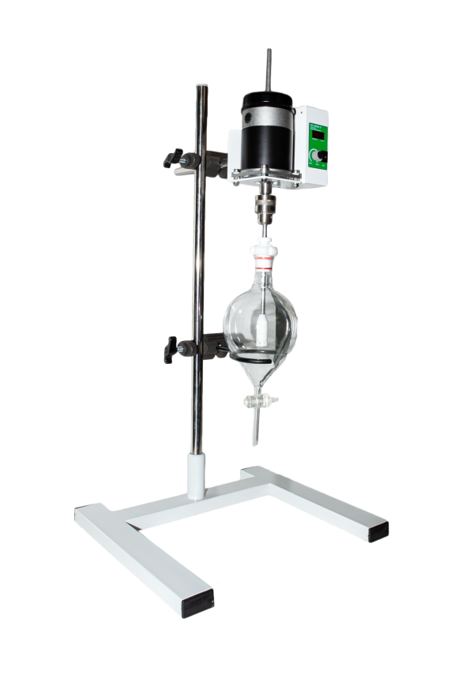

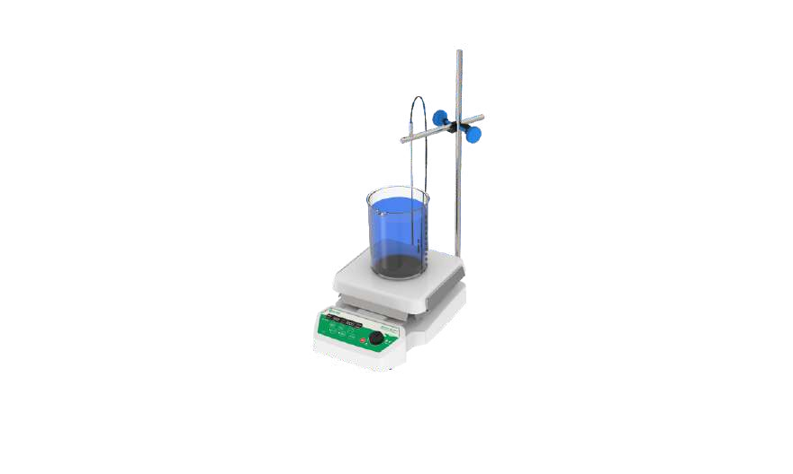
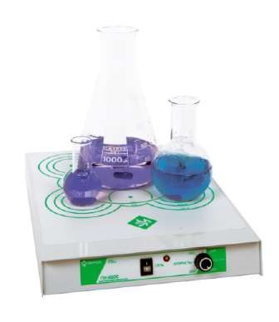
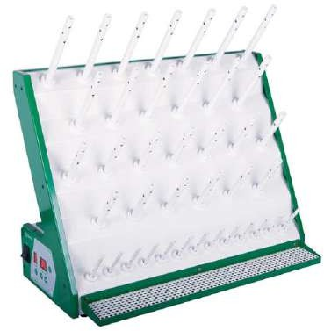
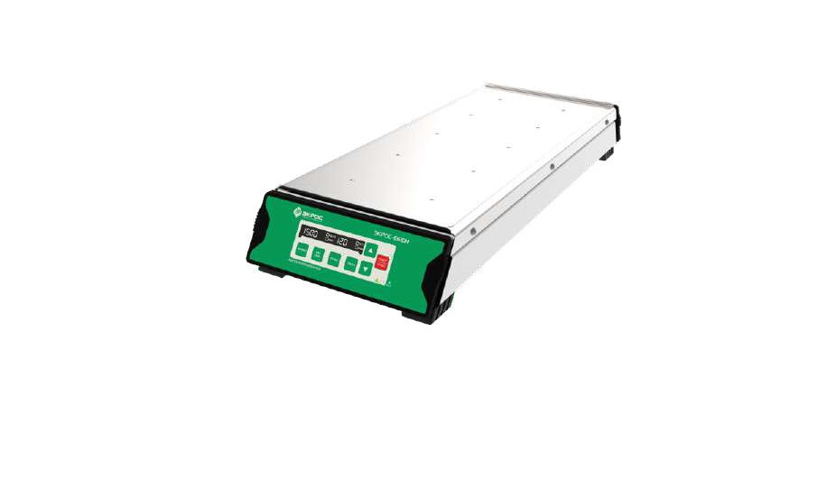
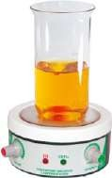
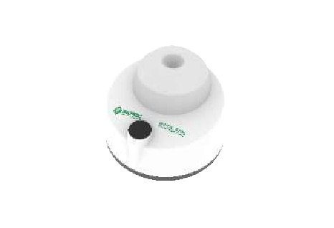
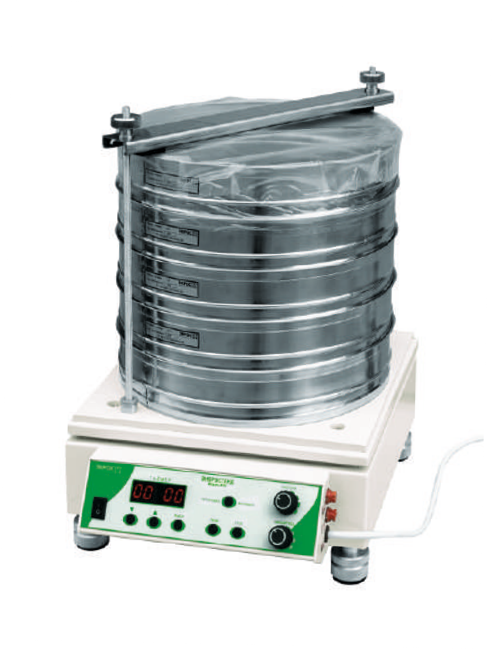
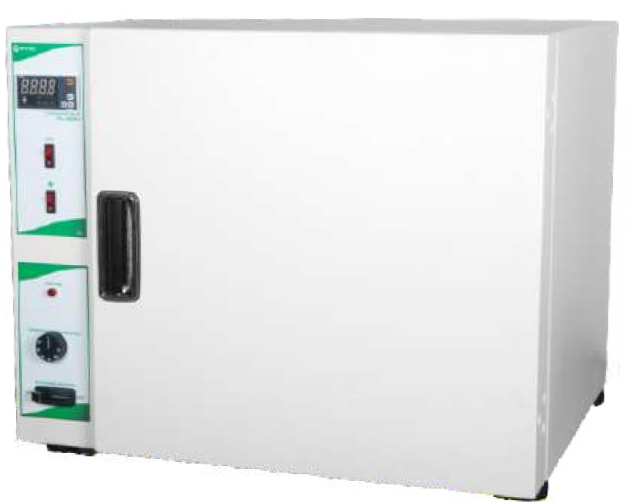
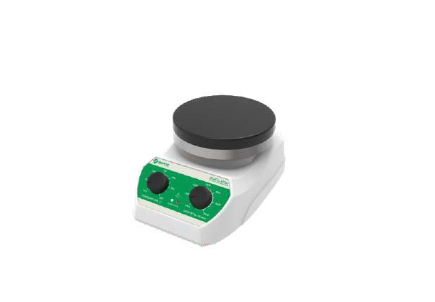

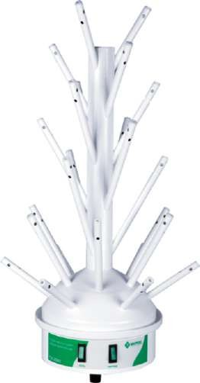
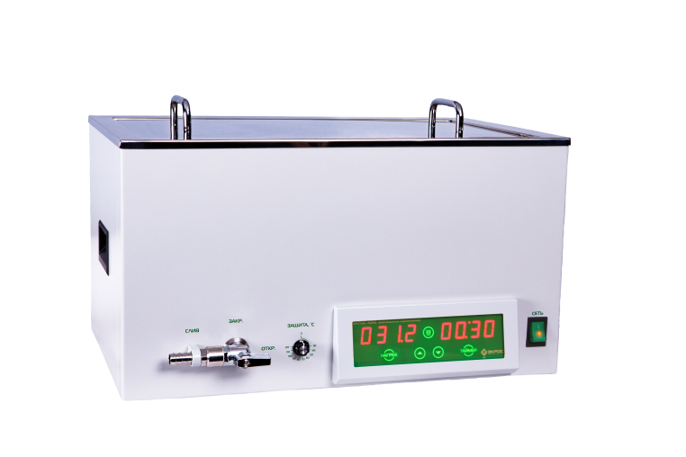
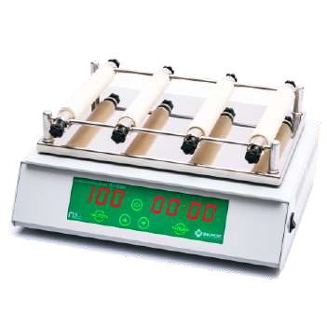
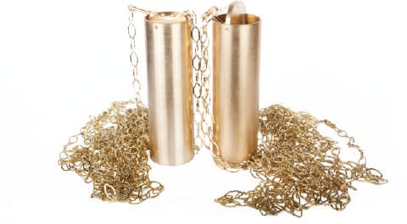
GENERAL LABORATORY EQUIPMENT
www.ecohim.ru

Slide 13

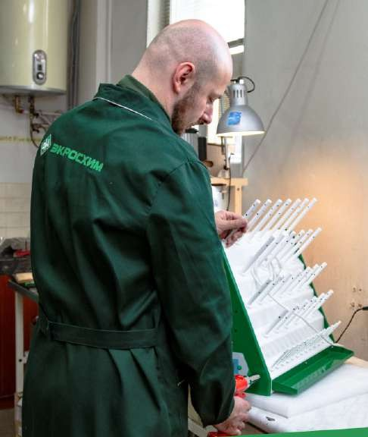
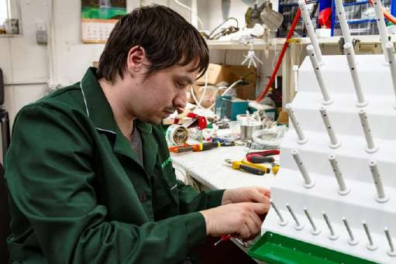

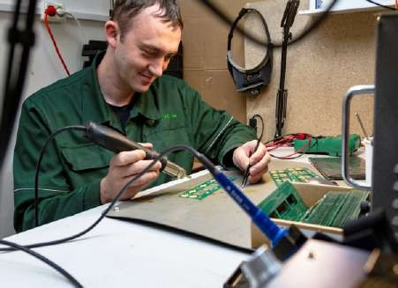
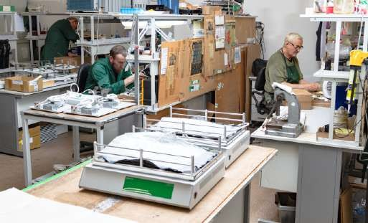
GENERAL LABORATORY EQUIPMENT MANUFACTURING
www.ecohim.ru

Slide 14


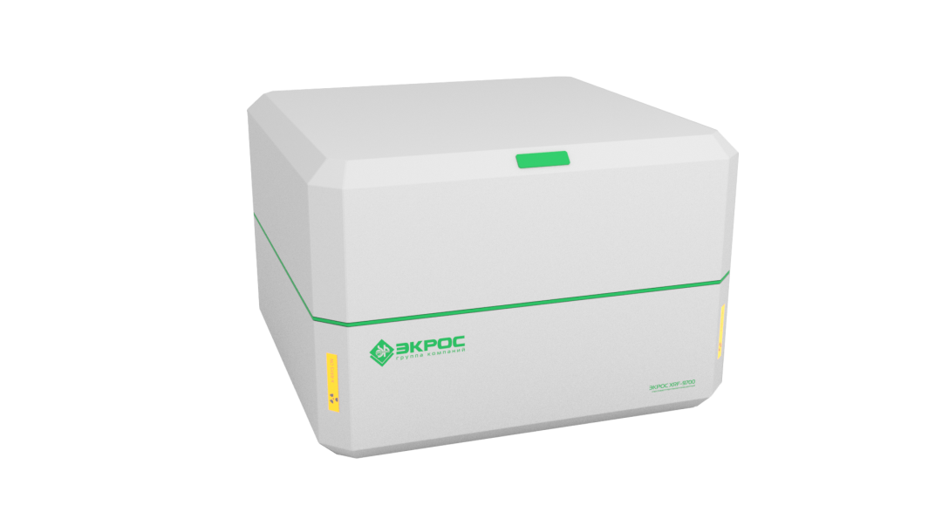






X-RAY FLUORESCENCE SPECTROMETER
ECROS XRF-9700
«STARFISH»
X-RAY ANALYTICAL INSTRUMENTS
X-RAY ANALYTICAL MICROSOPE ECROS XRF-9720
«STINGRAY»
ENERGY DISPERSIVE X-RAY FLUORESCENCE SULFUR-IN-OIL ANALYZER ECROS-7700
COMPACT X-RAY FLUORESCENCE SPECTROMETER
ECROS XRF-9710 «PEARL»
X-RAY BENCHTOP DIFFRACTOMETERS ECROS XRD
www.ecohim.ru

Slide 15







X-RAY EQUIPMENT MANUFACTURING
www.ecohim.ru

Slide 16





OPTICAL INSTRUMENTS:
Spectrophotometer PE-5300VI
Spectrophotometers
Petroleum products content meters
Petroleum products content meter ECROS-5700
Spectrophotometers
PE-5400VI and PE-5400UV
www.ecohim.ru

Slide 17







OPTICAL INSTRUMENTS PRODUCTION
www.ecohim.ru

Slide 18



ELECTRO-CHEMICAL EQUIPMENT:
Coulometric Karl Fisher titrator
with the reagent replacement unit
www.ecohim.ru

Slide 19



ELECTRO-CHEMICAL EQUIPMENT PRODUCTION
www.ecohim.ru

Slide 20


















Certified reference materials for oil and petroleum products analysis, gas chromatography, indicator PH paper, volumetric standards
www.ecohim.ru

Slide 21






Manufacturing of certified reference materials for oil and petroleum products analysis, gas chromatography, indicator PH paper, volumetric standards, buffer solutions
www.ecohim.ru

Slide 22


GLASS CAPILLAR VISCOMETERS
www.ecohim.ru

Slide 23









VISCOMETERS PRODUCTION
www.ecohim.ru

Slide 24








SALES TEAM
We are always happy to meet you!
+7(812) 322-96-00, 449-31-22, 449-31-23
sale@ecohim.ru
www.ecohim.ru

Slide 25





More than 4,000 trading organizations
The most reliable and largest companies for the supply of laboratory equipment.
More than 7,000 end users of our products: laboratories of the largest oil companies, industrial associations, state regulatory institutions, medical organizations, universities, schools, etc.
OUR PARTNERS
www.ecohim.ru

